Slide 1

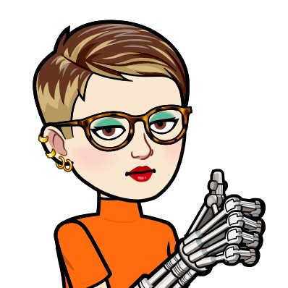
What Is AI?
Glenn Hills Middle School
Ms. A. New, M.ED., LIBRARY MEDIA SPECIALIST
SOURCE: COMMON SENSE MEDIA

Slide 2
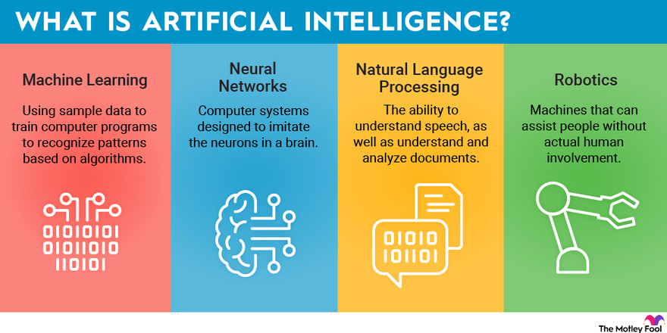
Essential Question
What is artificial intelligence and what are its
potential benefits and drawbacks?

Slide 3
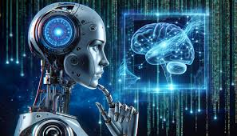
Learning Objectives
Define what artificial intelligence is.
Understand what makes generative AI unique.
Reflect on the benefits and drawbacks of
generative AI.

Slide 4
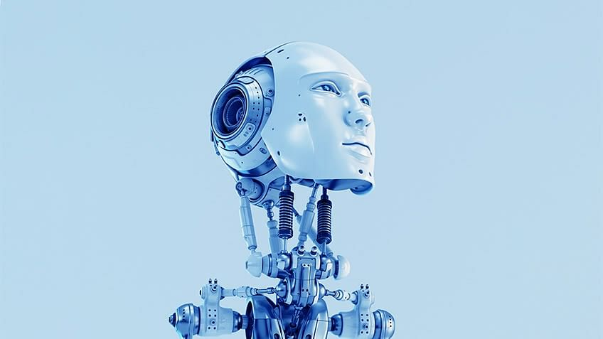
What Do You Already Know?
Where have you heard or seen AI?
What are some examples of things you think AI can do?

Slide 5
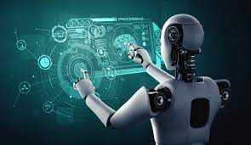
Key Vocabulary
We're going to watch a video that explains what
AI is. And we'll learn about a specific kind of AI that is quite popular right now, called generative AI, which is a type of AI that can create content, including text, images, and audio

Slide 6
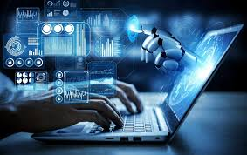

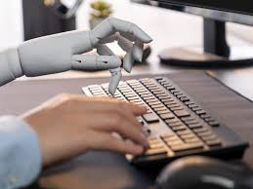
Generative AI
What is artificial intelligence?
How does artificial intelligence learn?
What makes
"generative AI" unique?

Slide 7
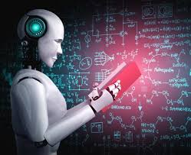
AI Explained
 | THINGS I HAVE LEARNED
WHAT IS ARTIFICIAL INTELLIGENCE?
HOW DOES ARTIFICIAL INTELLIGENCE “LEARN?”
WHAT MAKES “GENERATIVE AI” UNIQUE?

Slide 8
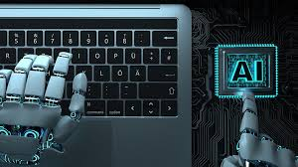
Key Vocabulary
Artificial Intelligence -
a computer program that can perform tasks that
typically require human intelligence
Artificial intelligence learns by
analyzing data, or information.
The more data you feed to an AI, the more accurate it can become at completing a task.

Slide 9
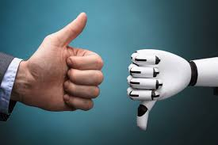
Is Generative AI Helpful or Harmful?
In the video, they mentioned some of the cool things generative AI can do, as well as some of the potential concerns, or things we should look out for when using it.
On a Post It Note, answer the following question…
Given what you know, do you think generative AI will be mostly helpful or harmful to society? Pick the side that you agree with the most. Be sure to write at least one reason to support your opinion.
Your teacher has placed two pieces of chart paper on the wall – one marked “AI is Helpful” and the other marked “AI is Harmful.” Place your answer on the appropriate chart.

Slide 10
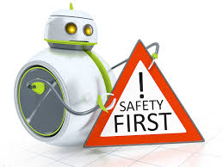
Ways It Could Be Harmful?
How could generative AI be harmful to society?
Misinformation: It could be used to create fake articles, videos, or images that are convincing and can be shared easily.
Plagiarism and copyright issues: It might have learned using data without permission, or it might not give credit to its sources.
Bias: It might be trained on biased or incomplete information.
Other harms: Impersonation, cyberbullying, privacy threats, etc.

Slide 11
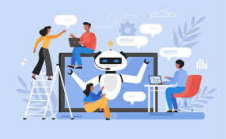
Ways It Could Be Helpful?
How could generative AI be helpful to society?
Efficiency: People could use it to be more productive in their jobs (data entry, writing, analyzing information, etc.)
Creativity: Could produce high-quality creative content, including art, music, and writing.
Learning: It can help people learn new skills.
Other helpful contributions?

Slide 12
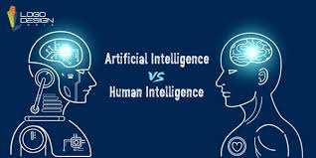
We Are In Control!
Balancing the potential benefits and drawbacks of a new technology can be tricky. When it comes to AI and generative AI, we must think critically about its impacts and remember that we're each in control of how we use it.

